Slide 1
Sentiment Analysis on Hotel Reviews Group 7 Ajith Busipally Pavansai Pottimuthi Siva Teja Segu Sreehari Revuri

Slide 2
Introduction
Sentiment analysis is a technique used in Natural Language Processing that extracts emotions from raw texts. Most ecommerce sites, including Amazon, Flipkart, and Google, have a variety of applications built on this technology.
Consider the Google Translate app. It is particularly good at comprehending, analyzing, and translating data.

Slide 3
Problem Statement
The project's goal is to perform sentiment analysis on a dataset of hotel reviews.
Given a customer review, we must predict whether the review is favorable or unfavorable, or positive or negative.
We want to predict whether a textual review corresponds to a positive (satisfied) or negative review (the customer is not satisfied).

Slide 4
Why is it important?
As it enables organizations to analyze massive volumes of unstructured data effectively and economically, sentiment analysis
is proven to be a useful tool.
It gives facts and quantifiable data for upcoming decision-making, and when done well, it delivers value to a business.
Sentiment research should be used by businesses that want to improve their goods and services, increase sales, and outwit their rivals.

Slide 5
Literature Review
Humera Shaziya et al. in this paper classified movie reviews for sentiment analysis using WEKA Tool. They enhanced the earlier work done in sentiment categorization which analyzes opinions which express either positive or negative sentiment
Nandal. in this paper classified amazon product reviews for sentiment analysis using SVM(Support Vector Machine) Tool. The study examined how words can shift in meaning depending on the context in which they're used, and how this impacts the overall evaluation of a product and its specific features. The findings of the analysis were impressive.

Slide 6
Proposal Model
The research began with an examination of many research and review articles on sentiment analysis, and each publication's summary was prepared by reading and comprehending the document.
Examine popular classification techniques such as Nave Bayes, Random Forest, k-nearest neighbor, Decision Tree Induction, and Support Vector Machine.

Slide 7
Milestones
Milestone 1: Data Preparation and data exploration
Pandas describe method will give some statistical parameters of the dataset like count, mean and standard deviation.
To get a quick overview of the dataset we will use the dataframe.info() function.

Slide 8
Milestones
Milestone 2: Data Cleaning
Cleaning and preprocessing of data
Using the gensim module, use the DOC2VEC function to convert text to vectors
By using SentimentIntensityAnalyzer we find the polarity scores and plot word cloud

Slide 9
Milestones
Milestone 3: Classifier
We will use Random forest as a learning method (it can be used for both classification and regression tasks)
It makes group of decision trees, usually trained with the “bagging” method

Slide 10
Milestones
Milestone 4: Performance & Evaluation
We will use ROC(Receiver Operating Characteristics) curve and AUC ( Area Under the Curve)
Through this we can evaluate false positive rate & true positive rate for each feasible cut-off value

Slide 11
Background
What is sentiment analysis?
Identify and extracting opinions and emotions expressed in text data using NLP techniques.
Encompass various techniques used to analyze the emotions, opinions, and attitudes expressed in text.
simple polarity classification to more advanced methods such as aspect-based sentiment analysis and emotion detection.
Notes:
1. It is a process of identifying and extracting opinions and emotions expressed in text data using natural language processing techniques
that tries to give machines and computer software the ability to understand the emotions of the user.
2. Sentiment analysis encompasses various techniques used to analyze the emotions, opinions, and attitudes expressed in text
3. The analysis can range from simple polarity classification to more advanced methods such as aspect-based sentiment analysis and emotion detection
4. It is important to know How customer feel about the products or services positive and negative words matter. They can boost the business efforts or can initiate a crisis.

Slide 12
Contd..
What is hotel review?
A hotel review is a brief statement expressing a person's evaluation of their experience staying at a particular hotel
Hotel review evaluations typically contain feedback on the overall experience by the guests
Notes:
Defines the quality of services mentioned by the guests in reviews
Guest reviews are becoming a prominent factor, they can clearly influence people's booking decisions.
Lets think about our own experience, When we want to go to a place to stay for a vacation, We generally check for the reviews before making decision to purchase a room there.
So Sentiment analysis can really help in identifying the flaws of the hotels or organization and can help them correct those for their business improvement.

Slide 13
Dataset
The following attributes are considered as our dataset:
Hotel-Address ReviewTotalPositiveWordCounts
Review-Date Average-Score
Hotel-Name Reviewer-Nationality
Negative-Review ReviewTotalNegativeWordCounts
Positive-Review ReviewTotalPositiveWordCounts
Reviewer-Score TotalNumberofReviewsReviewerHasGiven
TotalNumberof-Reviews Tags
Dayssincereview AdditionalNumberof-Scoring
Latitude Longitude
Notes:
Kaggle

Slide 14
Key Concepts
NLP(Natural Language Processing):
It has ability to not just read but understands and interpret human language.
NLP tools process data in real time, 24/7, and apply the same criteria to all your data, so you can ensure the results you receive are accurate – and not riddled with inconsistencies.
Notes:
Often used by businesses to automatically detect brand sentiment on social media. Analyzing these interactions can help brands detect urgent customer issues that they need to respond to right away, or monitor overall customer satisfaction.
Human language is complex, ambiguous, disorganized, and diverse. There are more than 6,500 languages in the world, all of them with their own syntactic and semantic rules. Even humans struggle to make sense of language.

Slide 15
Bag of Words ( BOW)
Raw text is initially preprocessed and the processing and cleaning techniques
Remove all unnecessary special characters, if there are words of other accent like polish, German, Spanish etc. Remove or replace them or add the right unicode to make them readable for machine.

Slide 16
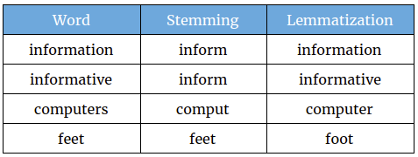
Lemmatization
Methods used by search engines and chatbots to analyze the meaning behind a word.
Stemming uses the stem of the word
Lemmatization uses the context in which the word is being used
Notes:
Lemmatization is one of the technique used to clean data.
Ppt
We are have two techniques to clean data, stemming and lemmatization
Stemming:
For example, consider word “information” , where the stemming convert these type of words to base word as “inform”.
Lemmatization used vocabulary and morphological analysis of words, normally aiming to remove inflectional endings only and to return the base or dictionary form of a word, which is known as the lemma(base)
Example:
For example, consider “ computers” from the table displayed. Lemmatization has converted it to dictionary form of word computer

Slide 17
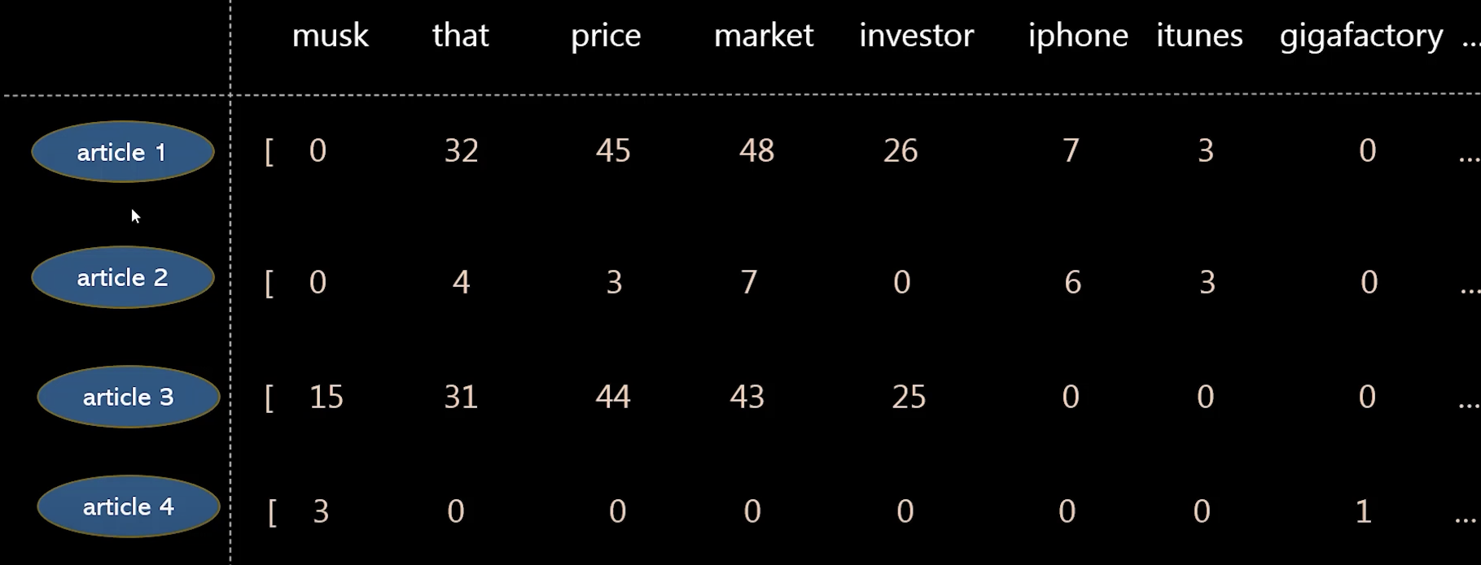
TF-IDF (Term Frequency and Inverse Dense Frequency)
Inverse document frequency looks at how common (or uncommon) a word is amongst the document
IDF =Log [(# Number of documents) / (Number of documents containing the word)]
Term frequency works by looking at the frequency of a particular term you are concerned with relative to the document
TF = (Number of repetitions of word in a document) / (# of words in document)
TF – IDF = TF(t, d) * IDF(t)
Notes:
So, using TF and IDF machine makes sense of important words in a document and important words throughout all documents.
IDF(t) = 4/1 = 4
TF = consider airtcle 1, where assume that it has total words 1000.
TF(t,d) = iphone(7)/1000 is TF value

Slide 18

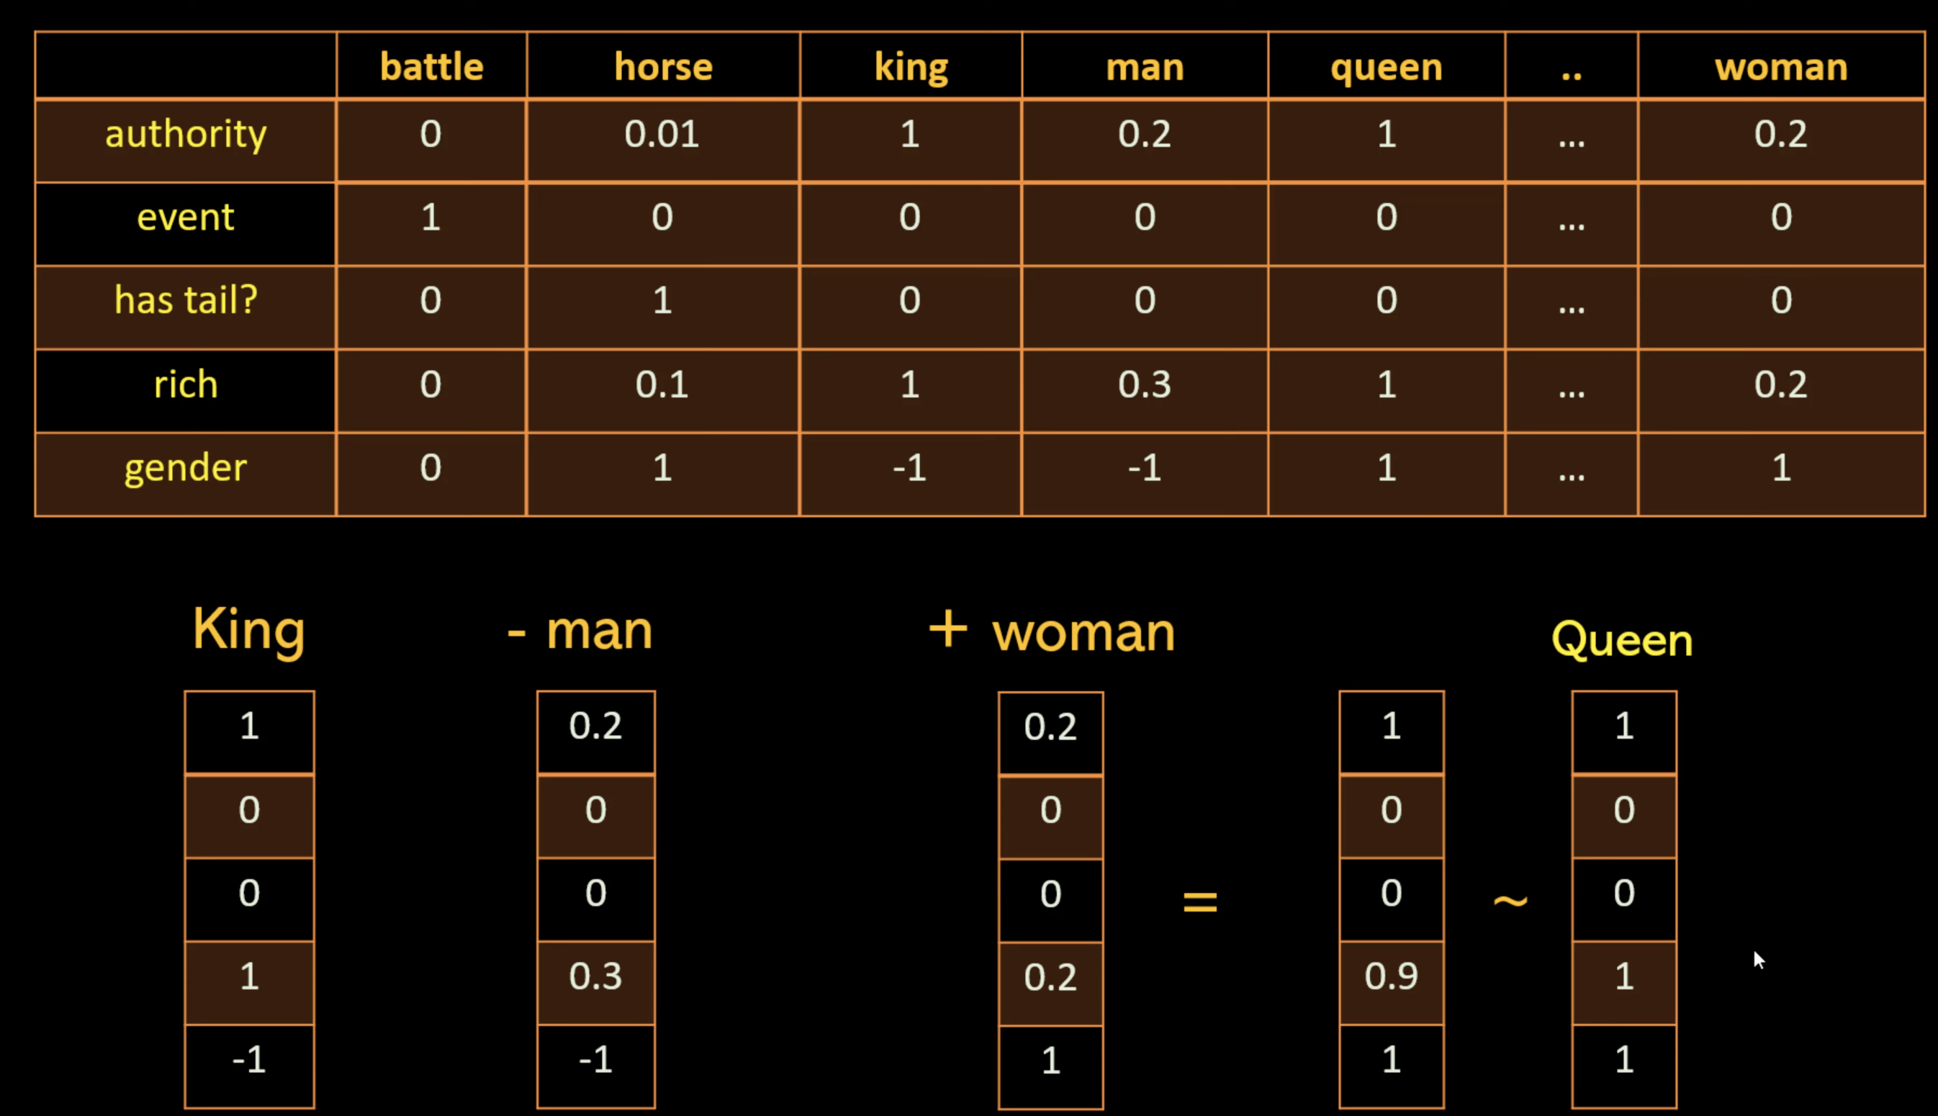
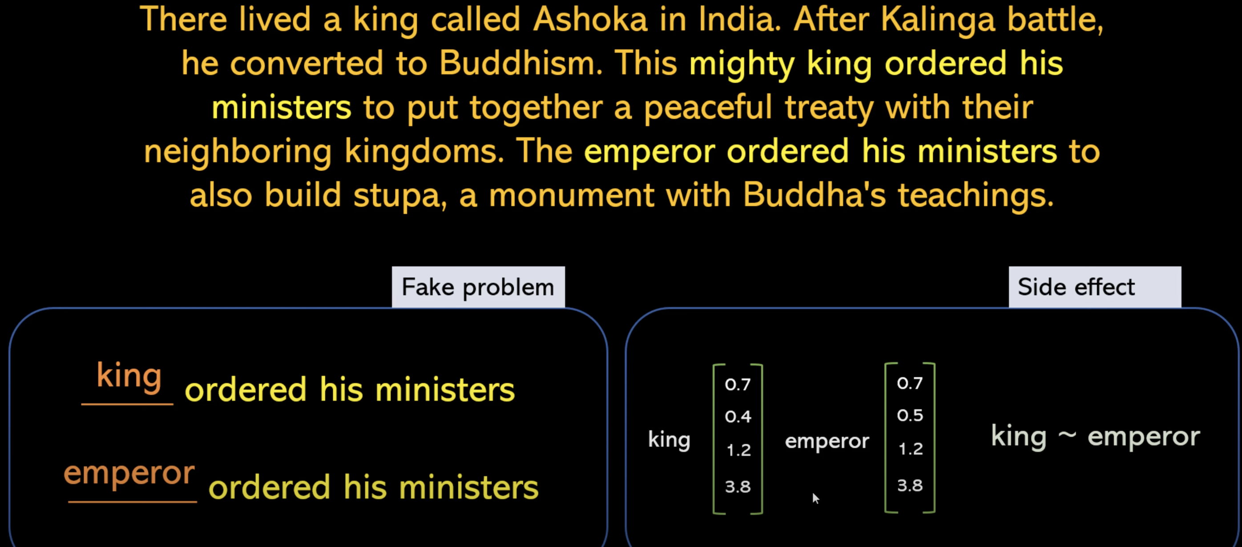
Word2vec
Word2Vec is a natural language processing technique used for generating word embeddings, which are numerical vector representations of words.
Notes:
Neural Network training is used to train word2vec.

Slide 19
Random Forest
It is flexible, easy to use machine learning algorithm that produces, even without hyper-parameter tuning.
The "forest" it builds, is an ensemble of decision trees, usually trained with the “bagging” method

Slide 20






Infrastructure

Slide 21
THANK YOU

